Slide 1
AUTOMATION OF TRAVEL AGENCY
By, SAURABH RAJ, ALAMGIR ALAM, ANUJ DEEP & ARITRA DATTA

Slide 2
ABSTRACT
The project Automation of Travel Agency helps all the citizens to book a cab easily through Internet at any time. The booking mechanism is fairly easy as the system becomes computerized.

Slide 3
Introduction and Objectives of the Project
Relevance of the Topic
The project is very much relevant in today’s world. Customers can very easily book a cab/ride through the web portal.
Problem Definition
The project Automation of Travel Agencies surely going to make booking a cab/ride a lot easier. Users can now book a cab from the comforts of their home.
Project Objective
To provide online booking facilities Support services in an integrated fashion so as to provide a simple and hassle free booking platform. The system interacts to the users (customer, admin) by means of some front-end form. To enter the system a sign in form will appear where username and Password for both Admins and for the Customers will have to be entered to log into the system and then this will check the Type of that user. According to type the System is loaded. After sign in customers enters into his profile. One can check the fare structure and book a ride. After sign in admin can enter into his profile. Admin can view the Vehicle list, Driver List and Route List. Admin can also update/modify/add the details of Vehicle, Driver and Route. New users must have to register before sign in. Every stage data is stored in the database. This is why the system is very easy to use and every user can accept the system by thinking its utility in present and by applying the idea of Spiral Model the system can be developed with more features in future.

Slide 4
Tools/Platform Requirement
Tools
Adobe Dreamweaver CS6
WAMP Package
Ms-Office
Dia tools
Platform
Microsoft Windows 7/8.1/10

Slide 5
Schema/Database Design
1. Table: USERPROFILE
This table contains User specific details entered during User Registration.
2. Table: VEHICLE
This table contains Vehicle specific information.
3. Table: DRIVER
This table contains Driver details like Name, address & License number etc.
4. Table: ROUTE
This table contains Route details like source, destination & distance etc.
5. Table: CONTACT
This table contains Contact details like name, email & message etc.
6. Table: ADMIN
This table contains Admin details like email & password etc.
7. Table: BOOKING
This table contains Booking details like BookingId, VehicleId, DriverId, Totalpayment, RouteId, Status etc.

Slide 6
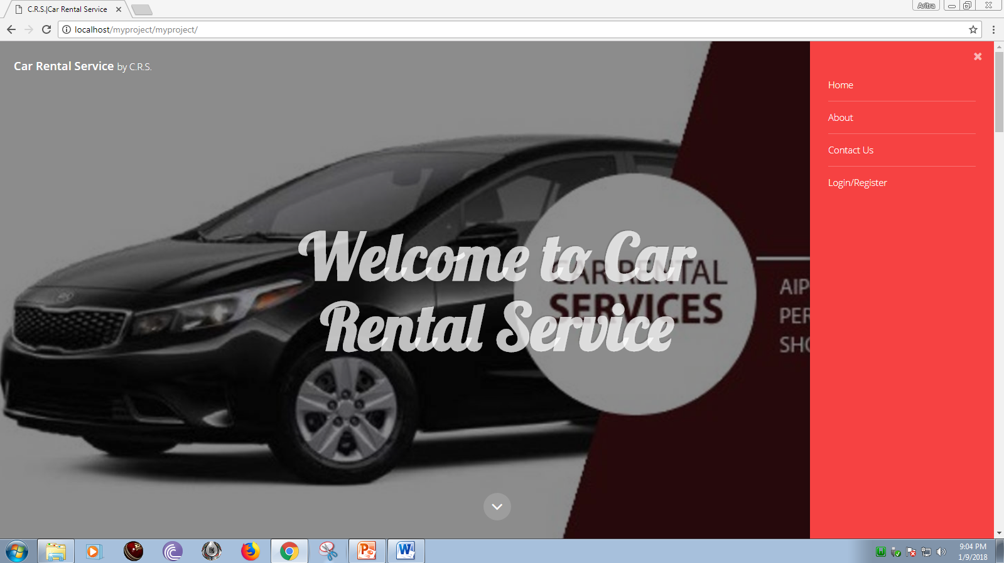
User Interface Design

Slide 7
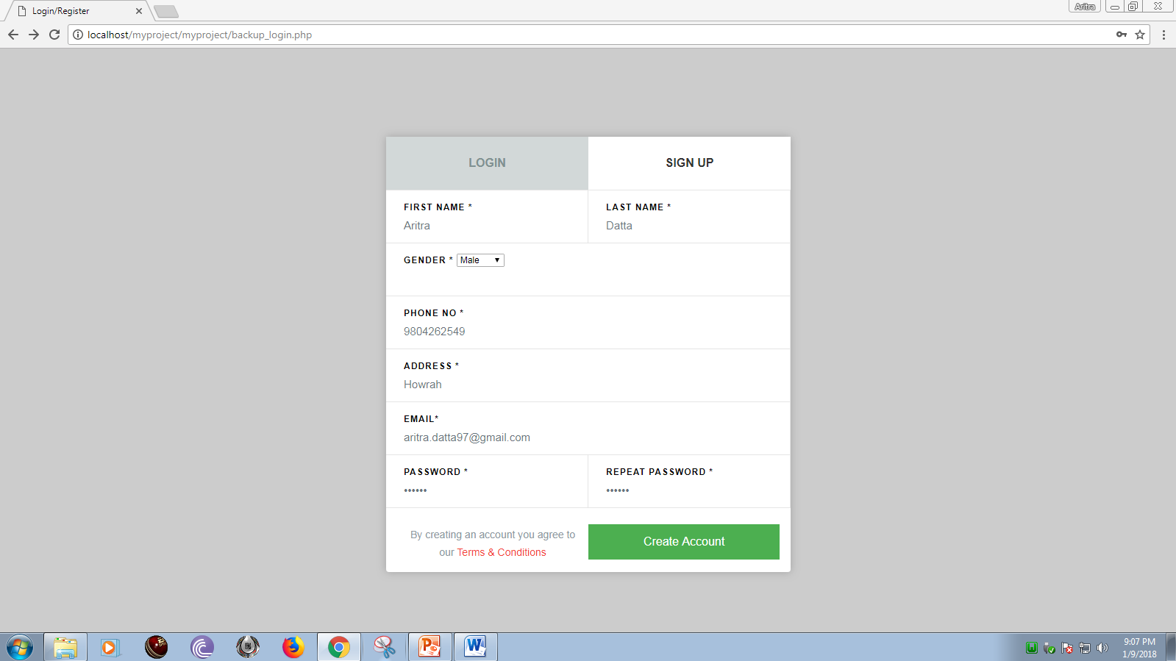
Login/sign up

Slide 8

After Login

Slide 9
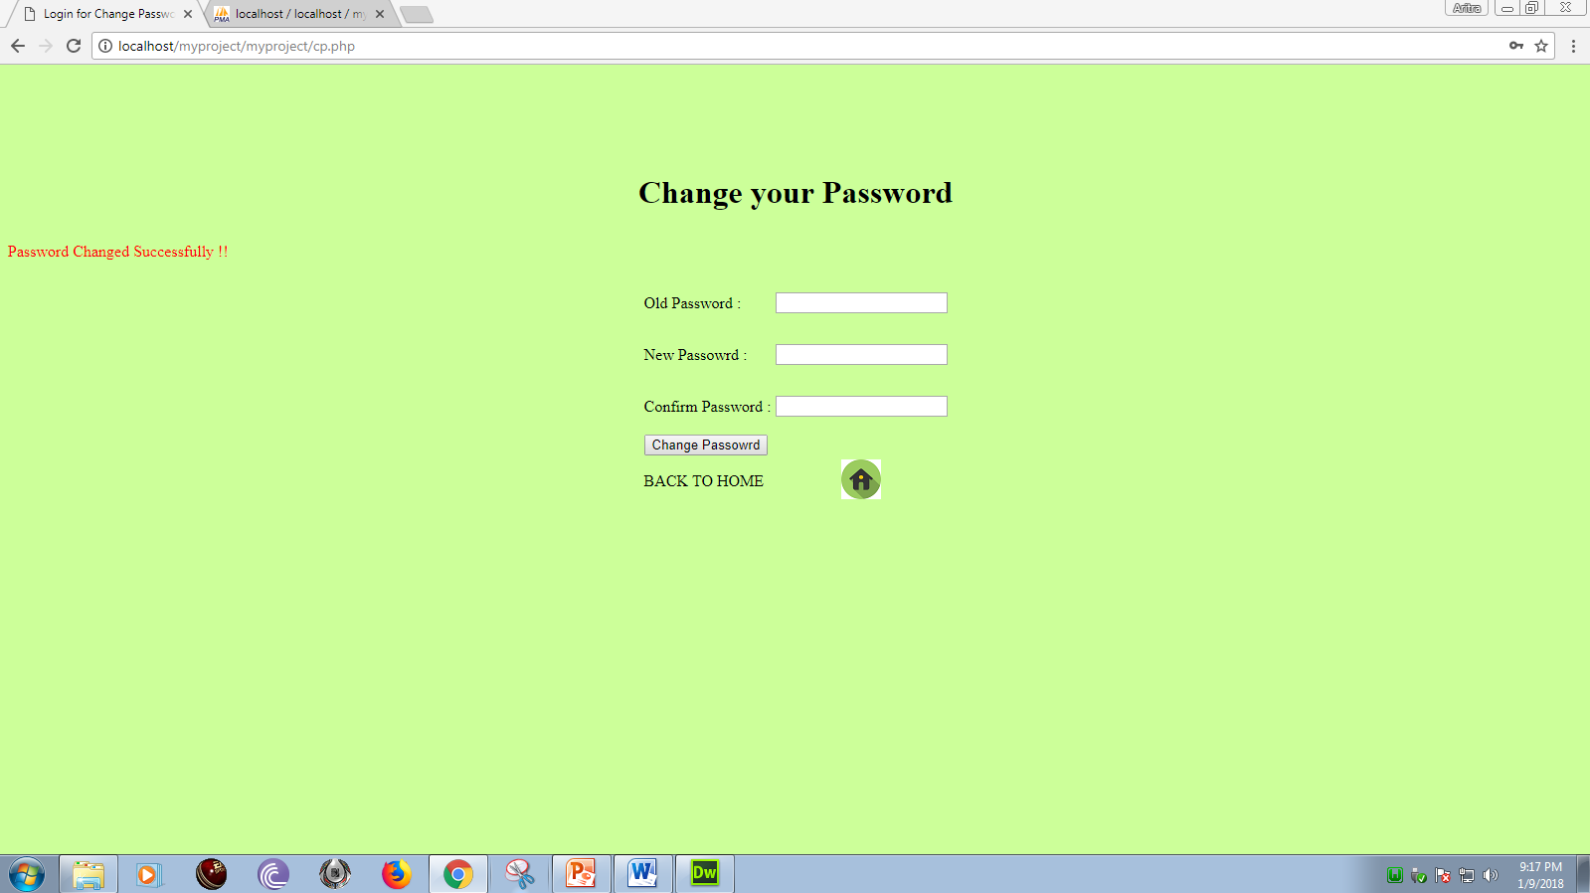
Change Password

Slide 10
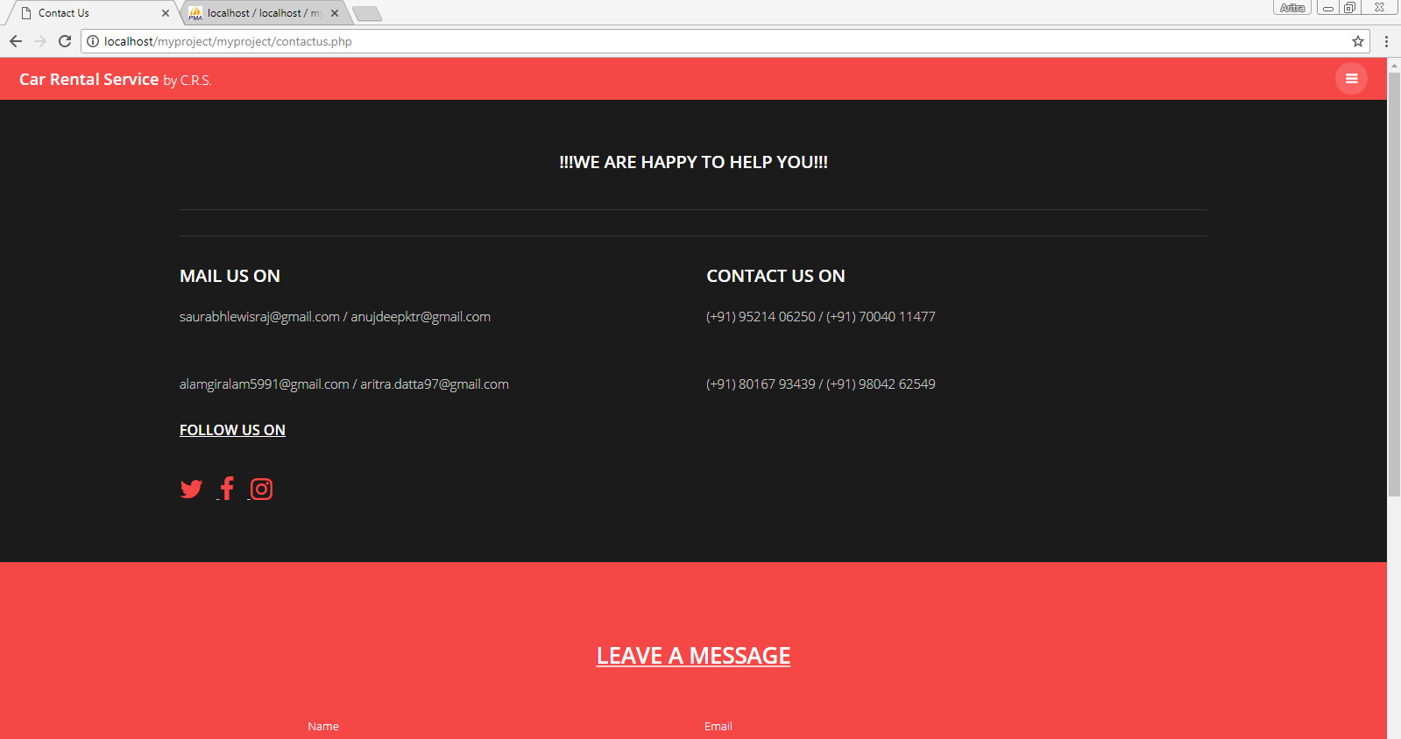
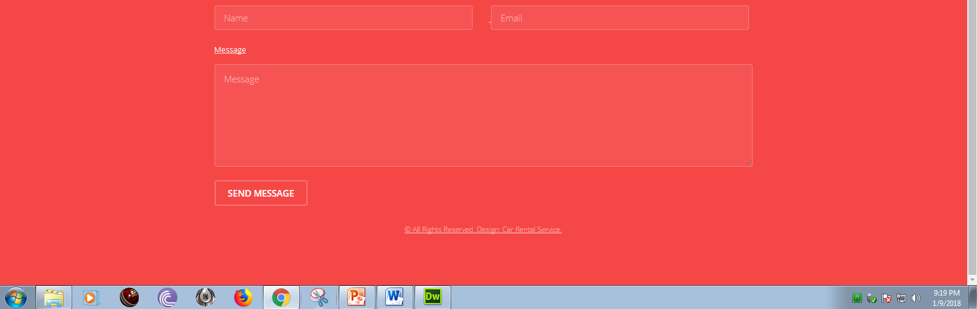
Contact Us

Slide 11
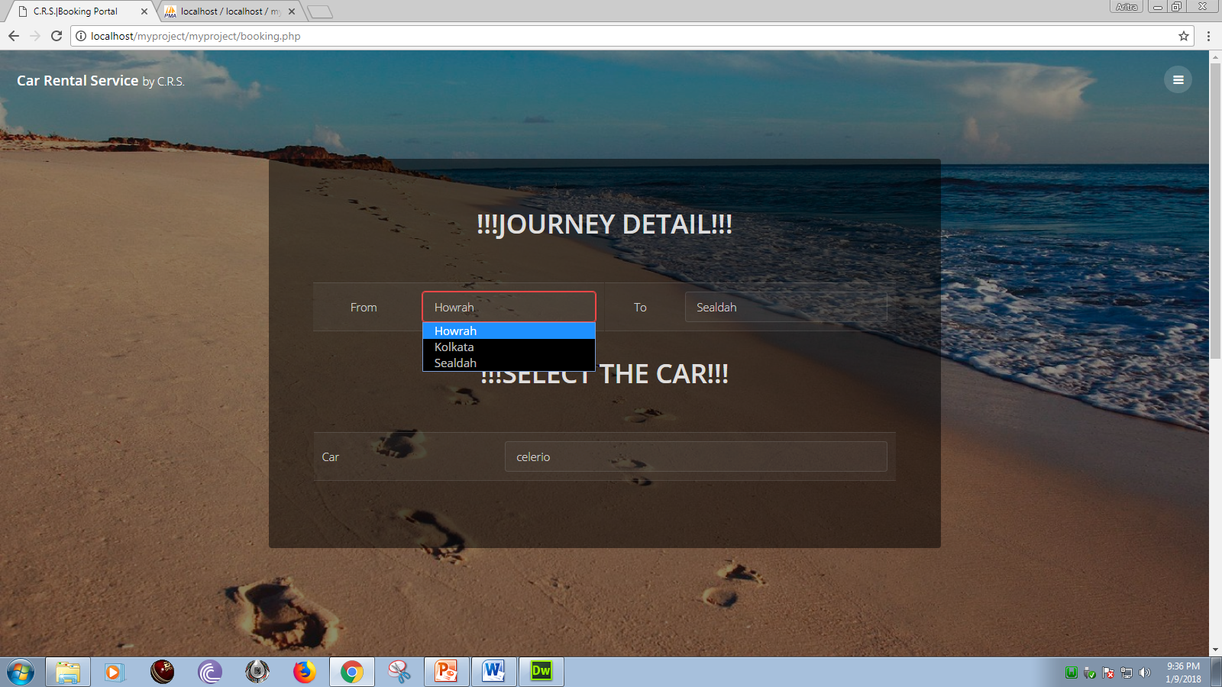
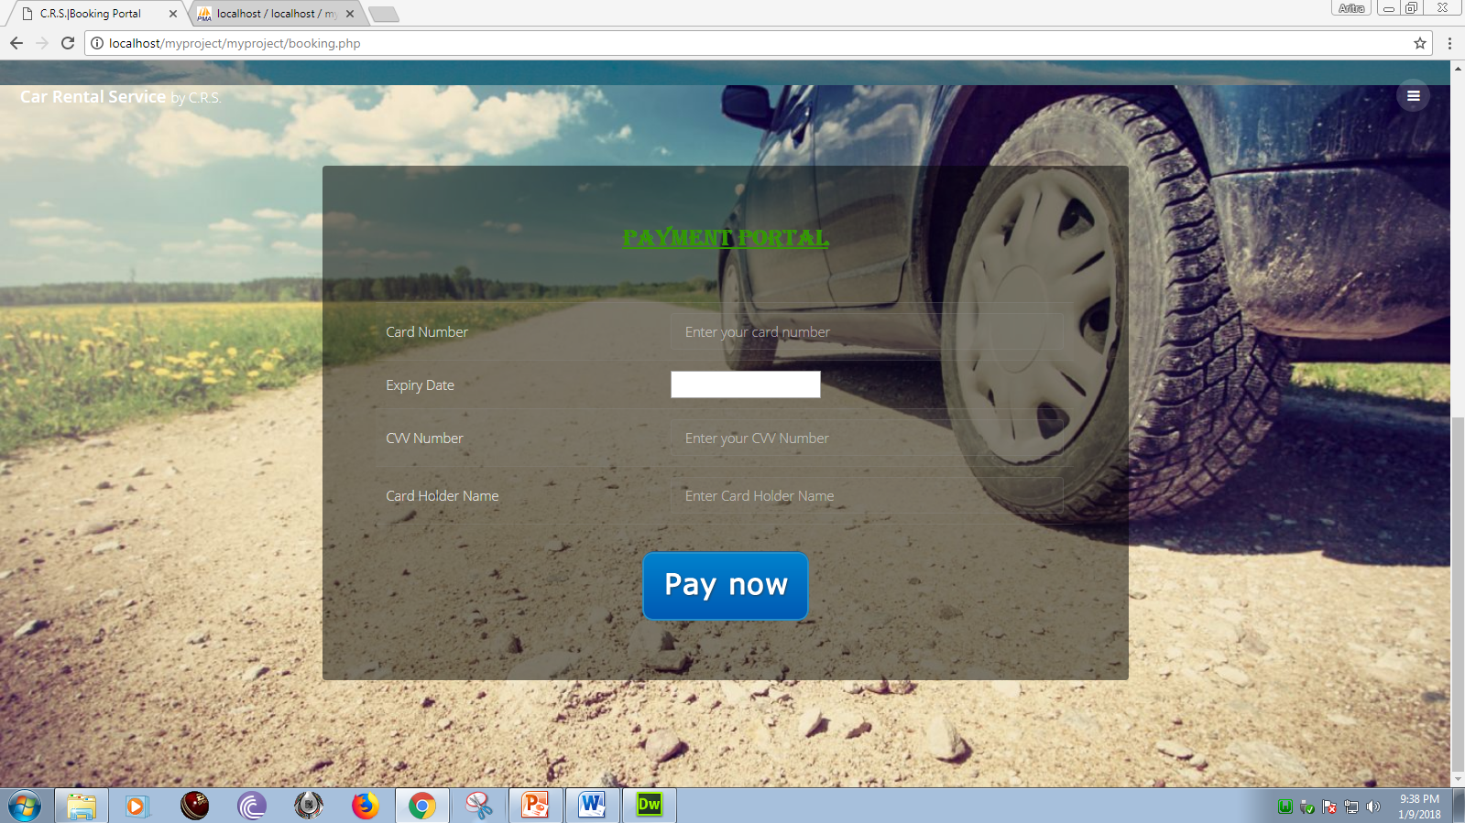
Booking

Slide 12
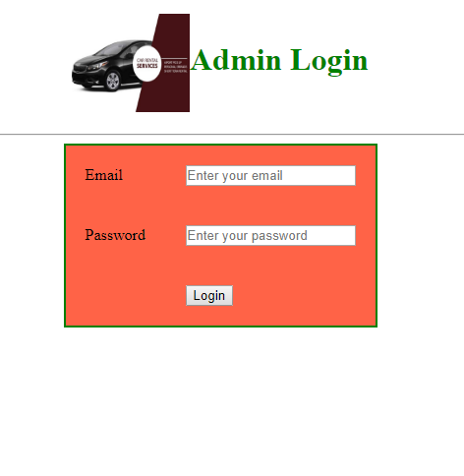
Admin Login

Slide 13
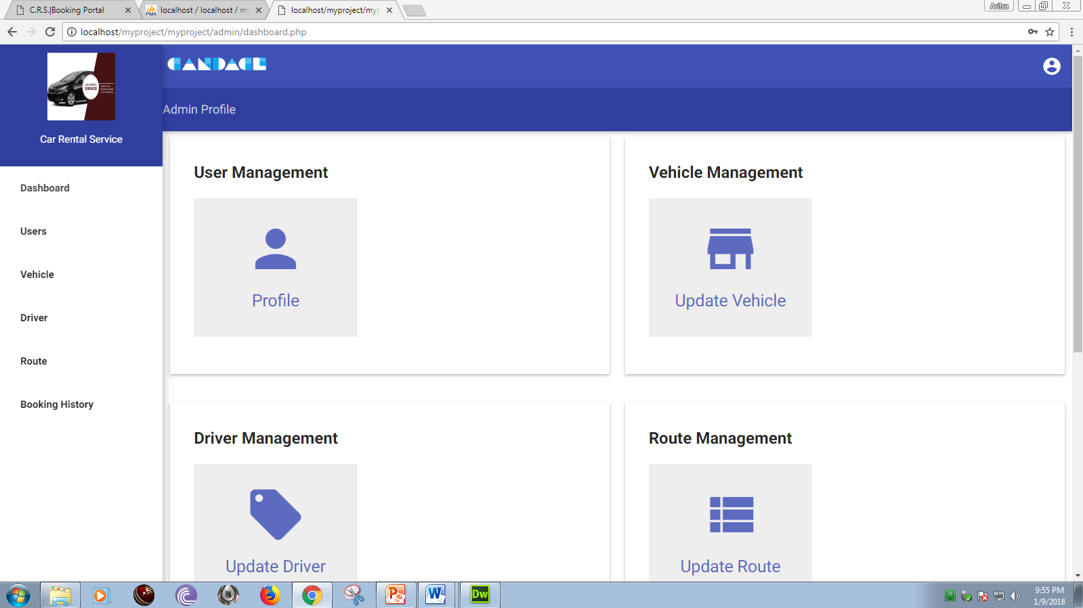
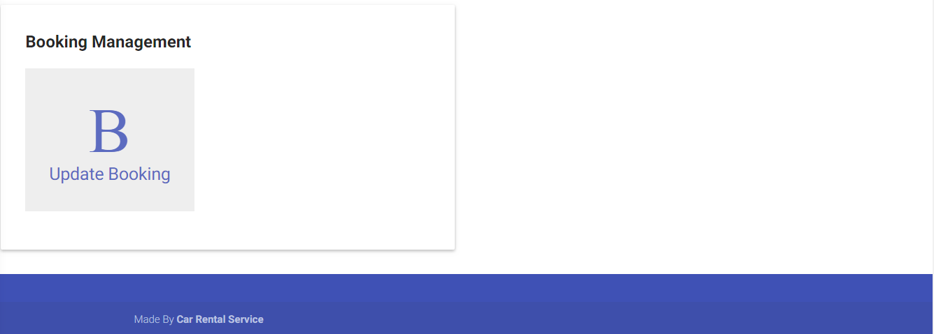
Admin Dashboard

Slide 14
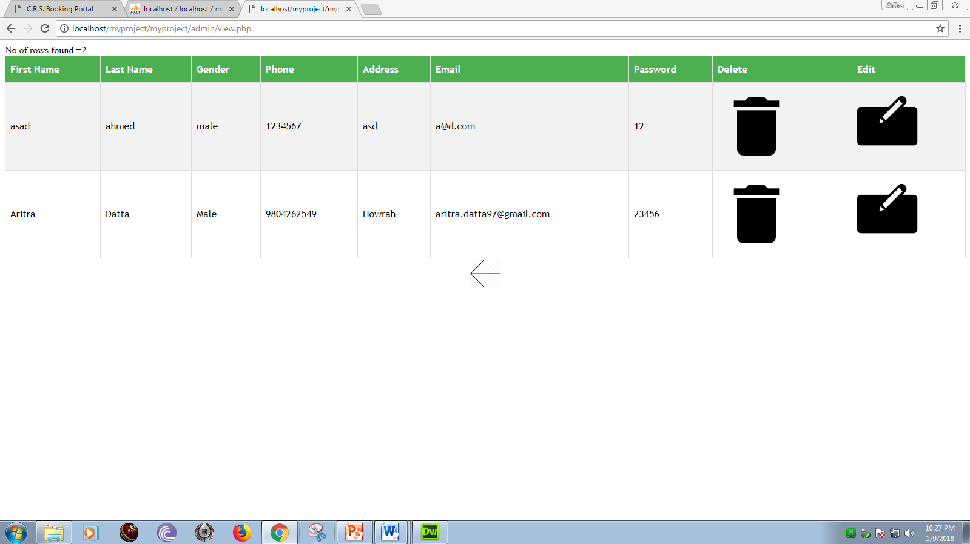
User Management

Slide 15
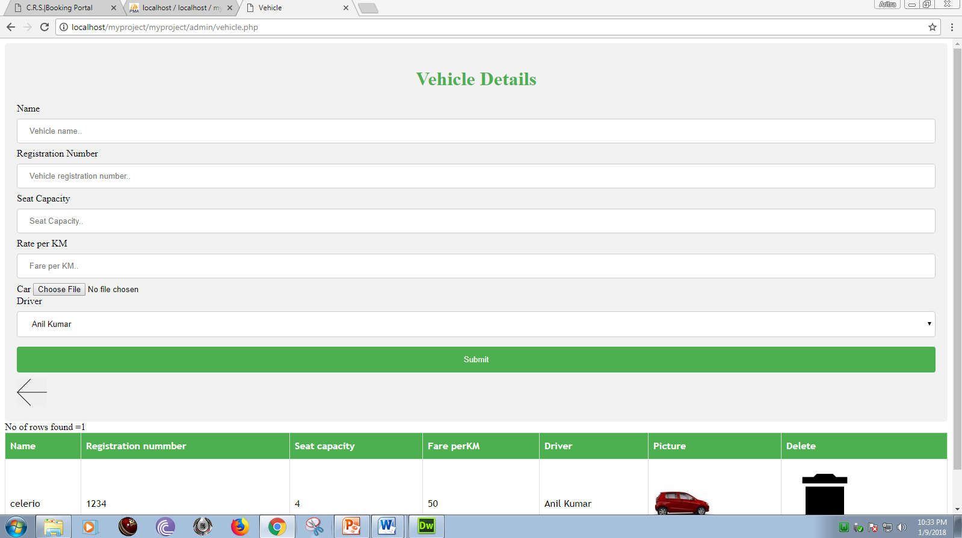
Vehicle Management

Slide 16
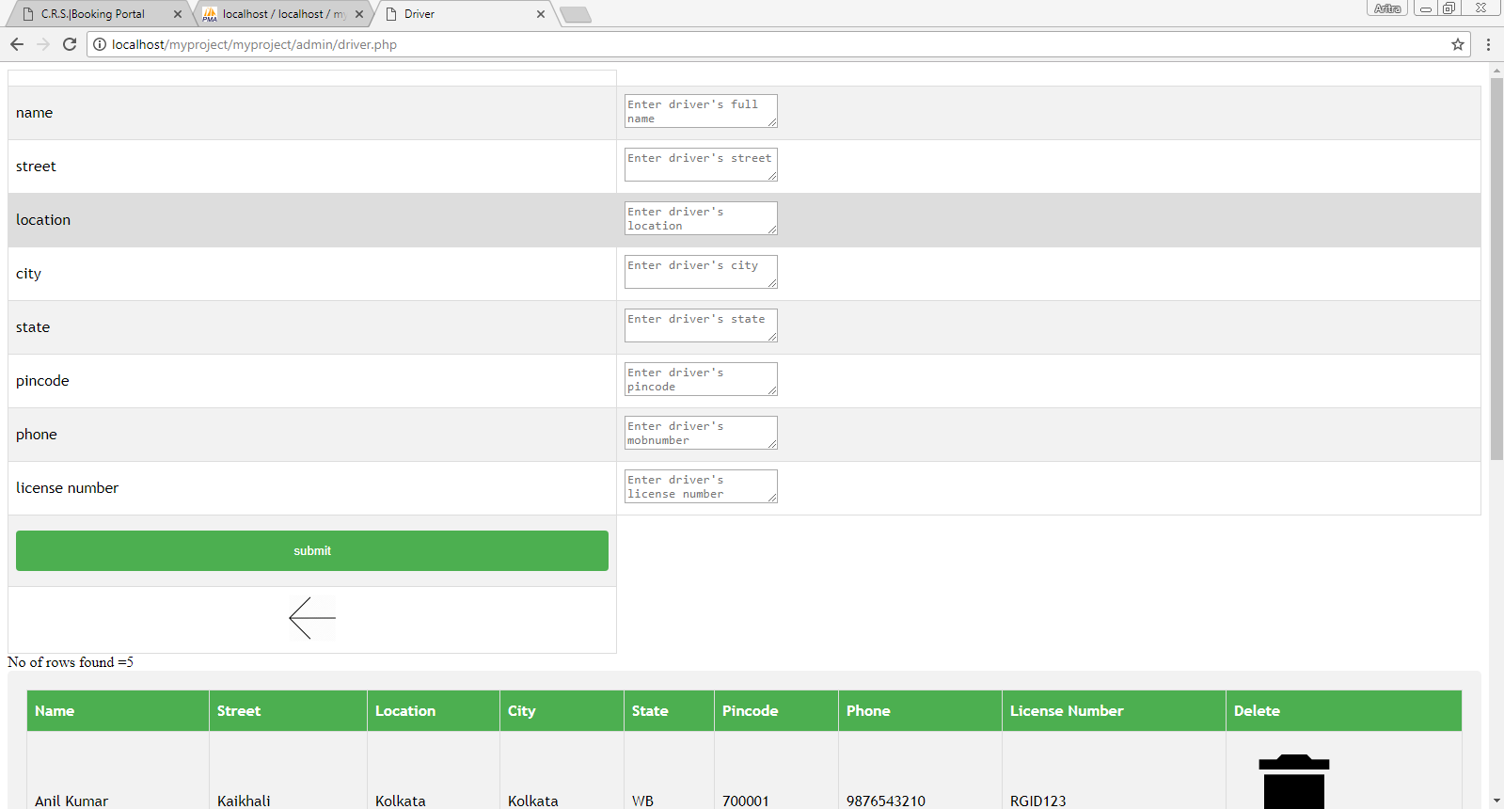
Driver Management

Slide 17
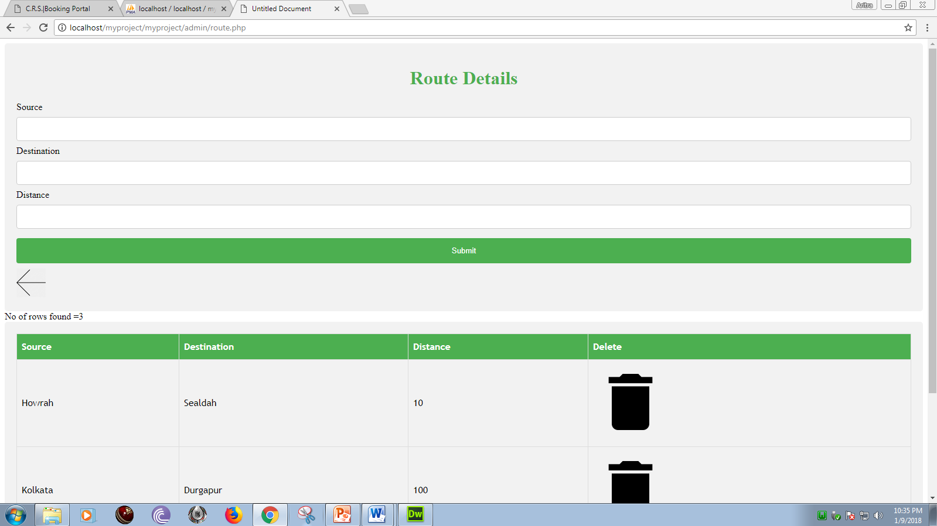
Route Management

Slide 18
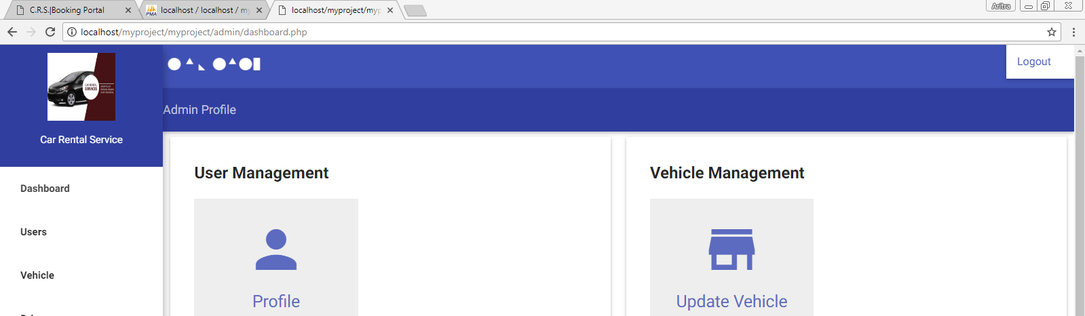
Log out

Slide 19
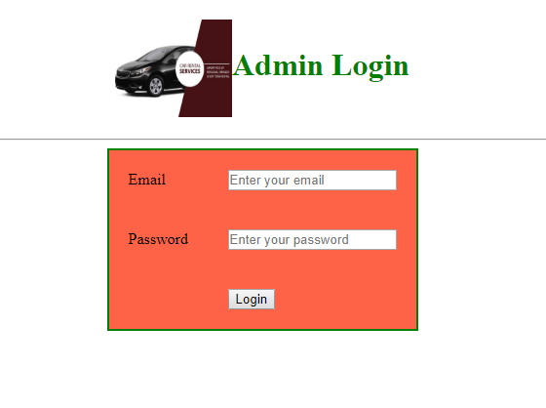
After Log out

Slide 20
Bibliography
Roger S. Pressman. Software Engineering: A Practioner's Approach (Sixth Edition, International Edition). McGraw-Hill, 2005.
Ian Sommerville. Software Engineering (Seventh Edition). Addison-Wesley, 2004.
Frederick P. Brooks. The Mythical Man-Month: Essays on Software Engineering, Anniversary Edition. Addison-Wesley Pub Co; 1st edition (August 2, 1995).
PHP and MySQL Web Development by Luke Welling
Learning PHP, MySQL, JavaScript, CSS... by Robin Nixon
PHP and MySQL for Beginners by Mark A Lassoff
Database System Concepts by Abraham Silberschatz, Henry F. Korth, S. Sudarshan
Database System, written by Connolly & Begg
HTML BY Davinder Singh Minhas
HTML and CSS: Design and Build Websites, Author: Jon Duckett

